Slide 1
UNIT-2
DESIGNING AND IMPLEMENTATION OF DATA WAREHOUSE

Slide 2
LOGICAL DESIGN FOR DATA WAREHOUSE
During the logical design phase, you defined a model for your data warehouse consisting of entities, attributes, and relationships.
The process of logical design involves arranging data into a series of logical relationships called entities and attributes.
An entity represents a chunk of Data Warehousing Schemas information.
An attribute is a component of an entity that helps define the uniqueness of the entity.
In relational databases, an attribute maps to a column. Also there is a unique identifier to define each records uniquely.

Slide 3
Features of a logical data model include:
Includes all entities and relationships among them.
All attributes for each entity are specified.
The primary key for each entity is specified.
Foreign keys (keys identifying the relationship between different entities) are specified.
Normalization occurs at this level.
The steps for designing the logical data model are as follows:
Specify primary keys for all entities.
Find the relationships between different entities.
Find all attributes for each entity.
Resolve many-to-many relationships.
Normalization.

Slide 4
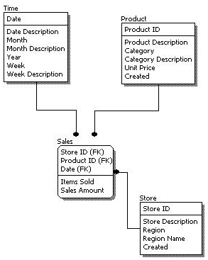
The figure below is an example of a logical design model.

Slide 5
PHYSICAL DESIGN FOR DATA WAREHOUSE
Physical design model represents how the model will be built in the database. A physical database model shows all table structures, including column name, column data type, column constraints, primary key, foreign key, and relationships between tables.
Features of a physical data model include:
Specification all tables and columns.
Foreign keys are used to identify relationships between tables.
Denormalization may occur based on user requirements.
Physical considerations may cause the physical data model to be quite different from the logical data model.
Physical data model will be different for different RDBMS. For example, data type for a column may be different between MySQL and SQL Server.

Slide 6
During the Physical design process, we convert the logical design into physical by using database structures. At this time, you have to map:
The steps for physical data model design are as follows:
Convert entities into tables.
Convert relationships into foreign keys.
Convert attributes into columns.
Modify the physical data model based on physical constraints / requirements.

Slide 7
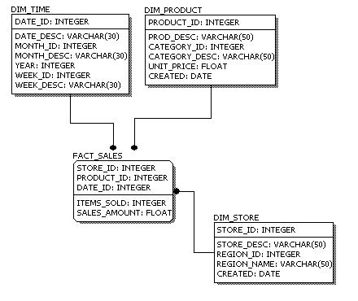
The figure below is an example of a physical data model.

Slide 8
DESIGN DIMENSION TABLE, FACT TABLE FOR DATA WAREHOUSE
Dimension:
A dimension is a structure that categorizes facts and measures in order to enable users to answer business questions. Commonly used dimensions are people, products, place and time.
In a data warehouse, dimensions provide structured labeling information.
The dimension is a data set composed of individual, non-overlapping data elements.
The primary functions of dimensions are threefold: to provide filtering, grouping and labelling.

Slide 9
A common data warehouse example involves sales as the measure, with customer and product as dimensions. In each sale a customer buys a product.
Types of Dimensions:
Types of Dimension | Definition
Conformed Dimensions | Conformed dimensions is the very fact to which it relates. This dimension is used in more than one-star schema or Datamart.
Outrigger Dimensions | A dimension may have a reference to another dimension table. These secondary dimensions called outrigger dimensions. This kind of Dimensions should be used carefully.

Slide 10
Shrunken Rollup Dimensions | Shrunken Rollup dimensions are a subdivision of rows and columns of a base dimension. These kinds of dimensions are useful for developing aggregated fact tables.
Dimension-to-Dimension Table Joins | Dimensions may have references to other dimensions. However, these relationships can be modeled with outrigger dimensions.
Role-Playing Dimensions | A single physical dimension helps to reference multiple times in a fact table as each reference linking to a logically distinct role for the dimension.
Junk Dimensions | It is a collection of random transactional codes, flags or text attributes. It may not logically belong to any specific dimension.

Slide 11
Degenerate Dimensions | Degenerate dimension is without corresponding dimension. It is used in the transaction and collecting snapshot fact tables. This kind of dimension does not have its dimension as it is derived from the fact table.
Swappable Dimensions | They are used when the same fact table is paired with different versions of the same dimension.
Step Dimensions | Sequential processes, like web page events, mostly have a separate row in a fact table for every step in a process. It tells where the specific step should be used in the overall session.

Slide 12
Dimension Table:
A dimension table contains dimensions of a fact.
They are joined to fact table via a foreign key.
Dimension tables are de-normalized tables.
The Dimension Attributes are the various columns in a dimension table
Dimensions offers descriptive characteristics of the facts with the help of their attributes.
The dimension can also contain one or more hierarchical relationships

Slide 13
A Dimension Table is a table in a star schema of a data warehouse.
Dimension tables are typically small, ranging from a few to several thousand rows.
For example:
A large credit card company could have a customer dimension with millions of rows.
The time dimension would contain every hour, day, week, month, quarter and year that has occurred since you started your business operations.
Product dimension could contain a name and description of products you sell, their unit price, color, weight and other attributes as applicable.

Slide 14
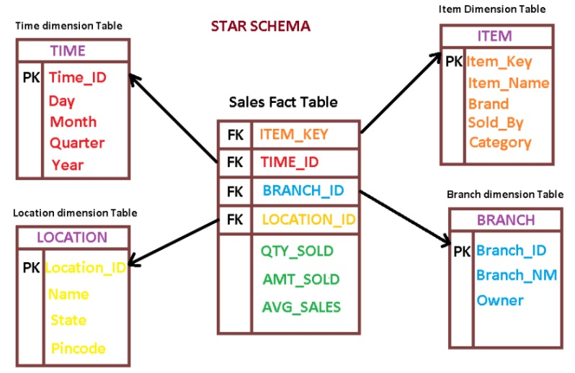
Design Examples:

Slide 15
Fact:
Fact is a thing that is known or proved to be true.
Or
Fact is an information used as evidence or as part of a report or news article.
Or
Fact is used to refer to a particular situation under discussion.

Slide 16
Type of facts | Explanation
Additive | Measures should be added to all dimensions.
Semi-Additive | In this type of facts, measures may be added to some dimensions and not with others.
Non-Additive | It stores some basic unit of measurement of a business process. Some real-world examples include sales, phone calls, and orders.

Slide 17
Fact Table:
A Fact Table is the central table in a star schema of a data warehouse. A fact table stores quantitative information for analysis and is often denormalized.
A fact table works with dimension tables and it holds the data to be analyzed and a dimension table stores data about the ways in which the data can be analyzed.
Thus, a fact table consists of two types of columns. The foreign keys column allows to join with dimension tables and the measure columns contain the data that is being analyzed.

Slide 18
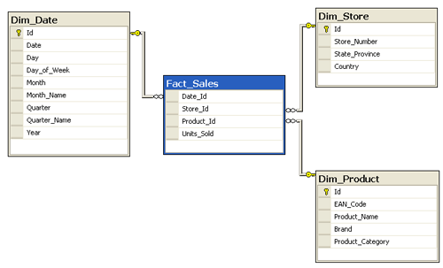
For example, sales amount would be a measure and this measure is stored in the fact table. For example, it can be the sales amount by each store, each day.
In this case, the fact table would contain three columns: A date column, a store column, and a sales amount column.

Slide 19
A fact table is a primary table in a dimensional model.
A Fact Table contains:
Measurements/facts
Foreign key to dimension table
Foreign key
Measurements/facts

Slide 20
Difference between Dimension table vs. Fact table
Parameters | Fact Table | Dimension Table
Definition | Measurements, metrics or facts about a business process. | Companion table to the fact table contains descriptive attributes to be used as query constraining.
Characteristic | Located at the center of a star or snowflake schema and surrounded by dimensions. | Connected to the fact table and located at the edges of the star or snowflake schema
Design | Defined by their grain or its most atomic level. | Should be wordy, descriptive, complete, and quality assured.
Task | Fact table is a measurable event for which dimension table data is collected and is used for analysis and reporting. | Collection of reference information about a business.

Slide 21
Type of Data | Facts tables could contain information like sales against a set of dimensions like Product and Date. | Evert dimension table contains attributes which describe the details of the dimension. E.g., Product dimensions can contain Product ID, Product Category, etc.
Key | Primary Key in fact is mapped as foreign keys to Dimensions. | Foreign key to the facts table
Storage | Helps to store report labels and filter domain values in dimension tables. | Load detailed atomic data into dimensional structures.
Hierarchy | Does not contain Hierarchy | Contains Hierarchies. For example Location could contain, country, pin code, state, city, etc.

Slide 22
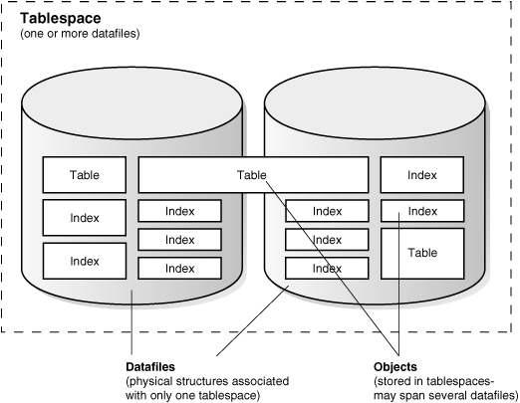
Table Space:
A table space is a storage structure, it contains tables, indexes, large objects, and long data.
It can be used to organize data in a database into logical storage group which is related with where data stored on a system. This tables paces are stored in database partition groups.

Slide 23
Benefits of table spaces in database:
The table spaces are beneficial in database in various ways given as follows:
Recoverability: Tablespaces make backup and restore operations more convenient. Using a single command, you can make backup or restore all the database objects in tablespaces.
Automatic storage Management: Database manager creates and extends containers depending on the needs.
Memory utilization: A single bufferpool can manage multiple tablespaces. You can assign temporary tablespaces to their own bufferpool to increase the performance of activities such as sorts or joins.

Slide 24
DESIGN AND IMPLEMENT EFFECTIVE PHYSICAL DATA STRUCTURE FOR DATA WAREHOUSE
Schema:
Schema is a logical description of the entire database.
It includes the name and description of records of all record types including all associated data-items and aggregates. Much like a database, a data warehouse also requires to maintain a schema.
A database uses relational model, while a data warehouse uses Star, Snowflake, and Fact Constellation schema.
A schema is a collection of database objects, including tables, views, indexes, and synonyms.
You can arrange schema objects in the schema models designed for data warehousing in a variety of ways.
Most data warehouses use a dimensional model.

Slide 25
Star Schema:
The star schema is the simplest type of Data Warehouse schema.
It is known as star schema as its structure resembles a star.
In the Star schema, the center of the star can have one fact tables and numbers of associated dimension tables.
It is also known as Star Join Schema and is optimized for querying large data sets.
A star schema can be simple or complex. A simple star consists of one fact table; a complex star can have more than one fact table.
The most natural way to model a data warehouse is as a star schema.

Slide 26
A star schema optimizes performance by keeping queries simple and providing fast response time.
In the star schema design, a single object (the fact table) sits in the middle and is radically connected to other surrounding objects (dimension lookup tables) like a star.
Each dimension is represented as a single table. The primary key in each dimension table is related to a foreign key in the fact table.
Let's look at an example-1: Assume our data warehouse keeps store sales data, and the different dimensions are time, store, product, and customer.
Note − Each dimension has only one dimension table and each table holds a set of attributes.

Slide 27
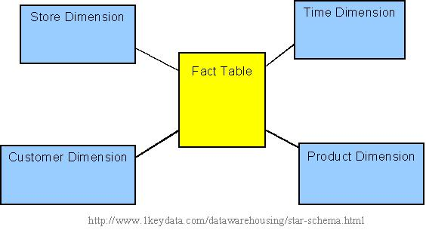
Example-1-Star schema

Slide 28
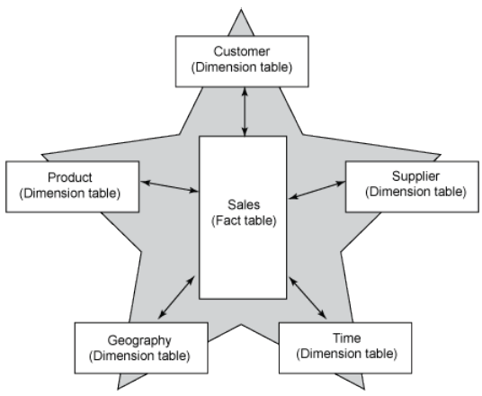
Example-2-Star schema

Slide 29
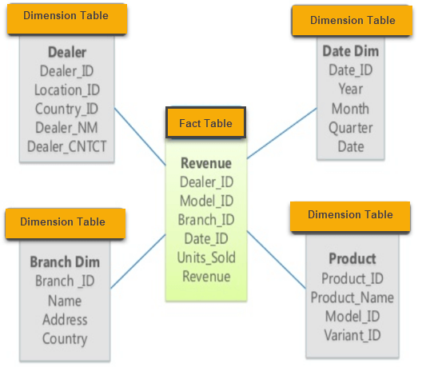
Example-3, as you can see in the above-given image that fact table is at the center which contains keys to every dimension table like Deal_ID, Model ID, Date_ID, Product_ID, Branch_ID & other attributes like Units sold and revenue.

Slide 30
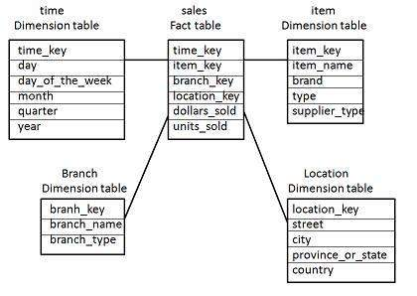
Example-4
The following diagram shows the sales data of a company with respect to the four dimensions, namely time, item, branch, and location.

Slide 31
Example-5

Slide 32
Characteristics of Star Schema:
Every dimension in a star schema is represented with the only one-dimension table.
The dimension table should contain the set of attributes.
The dimension table is joined to the fact table using a foreign key
The dimension table are not joined to each other
Fact table would contain key and measure
The Star schema is easy to understand and provides optimal disk usage.
The dimension tables are not normalized.

Slide 33
Snowflake Schema:
A Snowflake Schema is an extension of a Star Schema, and it adds additional dimensions.
It is called snowflake because its diagram resembles a Snowflake.
The dimension tables are normalized which splits data into additional tables.
In the following example, Country is further normalized into an individual table.

Slide 34
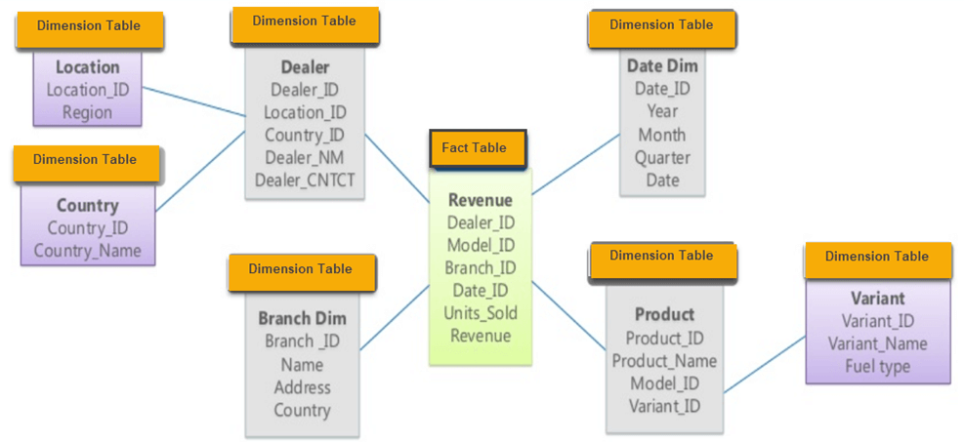
Example: Snowflake Schema

Slide 35
Characteristics of Snowflake Schema:
The main benefit of the snowflake schema it uses smaller disk space.
Easier to implement a dimension is added to the Schema
Due to multiple tables query performance is reduced
The primary challenge that you will face while using the snowflake Schema is that you need to perform more maintenance efforts because of the more lookup tables.

Slide 36
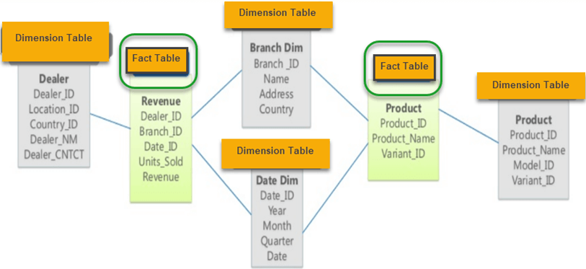
Fact Constellation(Galaxy) Schema:
A constellation schema contains two fact table that shares dimension tables.
It is also called Galaxy Schema. The schema is viewed as a collection of stars hence the name Galaxy Schema.
Example:1

Slide 37
Star Vs Snowflake Schema: Key Differences:
Star Schema | Snow Flake Schema
Hierarchies for the dimensions are stored in the dimensional table. | Hierarchies are divided into separate tables.
It contains a fact table surrounded by dimension tables. | One fact table surrounded by dimension table which are in turn surrounded by dimension table
In a star schema, only single join creates the relationship between the fact table and any dimension tables. | A snowflake schema requires many joins to fetch the data.
Simple DB Design. | Very Complex DB Design.
Denormalized Data structure and query also run faster. | Normalized Data Structure.
High level of Data redundancy | Very low-level data redundancy
Single Dimension table contains aggregated data. | Data Split into different Dimension Tables.

Slide 38
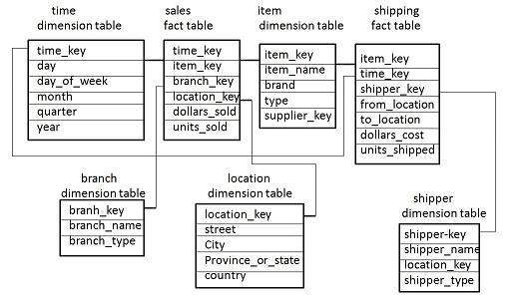
As you can see in above figure, there are two facts table: Revenue and Product.
In Galaxy schema shares dimensions are called Conformed Dimensions.
Example: 2

Slide 39
The above diagram shows two fact tables, namely sales and shipping.
The sales fact table is same as that in the star schema.
The shipping fact table has the five dimensions, namely item_key, time_key, shipper_key, from_location, to_location.
The shipping fact table also contains two measures, namely dollars sold and units sold.
It is also possible to share dimension tables between fact tables. For example, time, item, and location dimension tables are shared between the sales and shipping fact table.

Slide 40
Characteristics of Constellation(Galaxy) Schema:
The dimensions in this schema are separated into separate dimensions based on the various levels of hierarchy.
For example, if geography has four levels of hierarchy like region, country, state, and city then Galaxy schema should have four dimensions.
Moreover, it is possible to build this type of schema by splitting the one-star schema into more Star schemes.
The dimensions are large in this schema which is needed to build based on the levels of hierarchy.
This schema is helpful for aggregating fact tables for better understanding.

